Slide 1
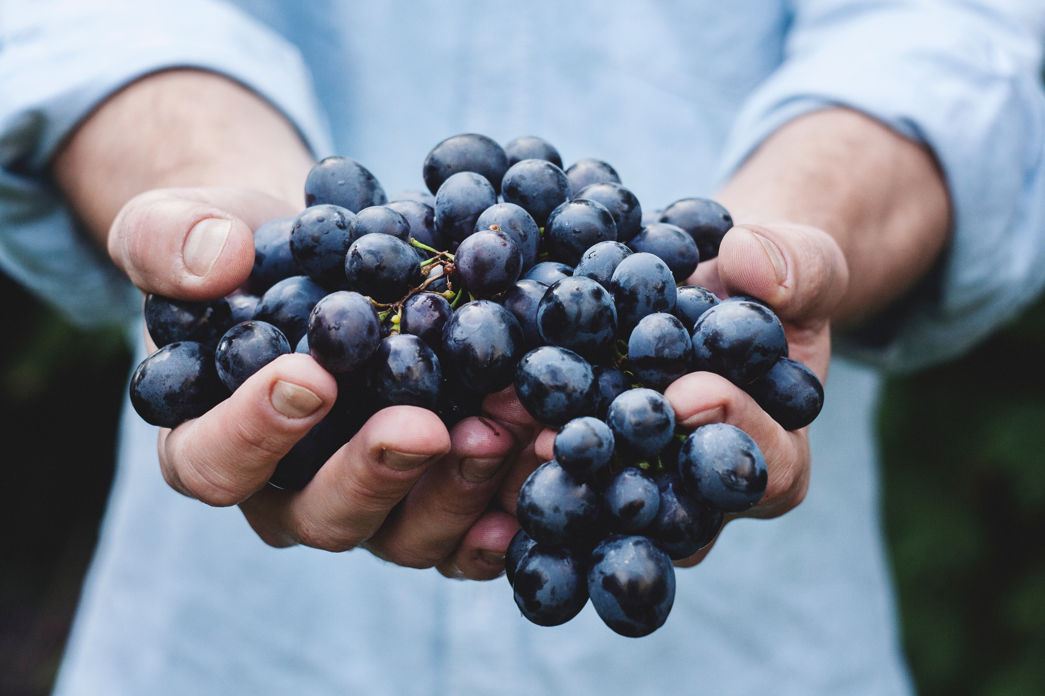
Quick, easy, tasty snacks
Lauren Shelor, rd, ldn, ciec
Health educator, Hokie Wellness

Slide 2
How to build a good snack
CARBS
give you immediate energy
+
PROTEIN
helps you feel fuller for longer
important for repairing muscle after exercise or hard work
+
FAT
helps you feel satisfied and stay fuller for longer
+
FIBER
also helps you feel satisfied and stay fuller for longer

Slide 3
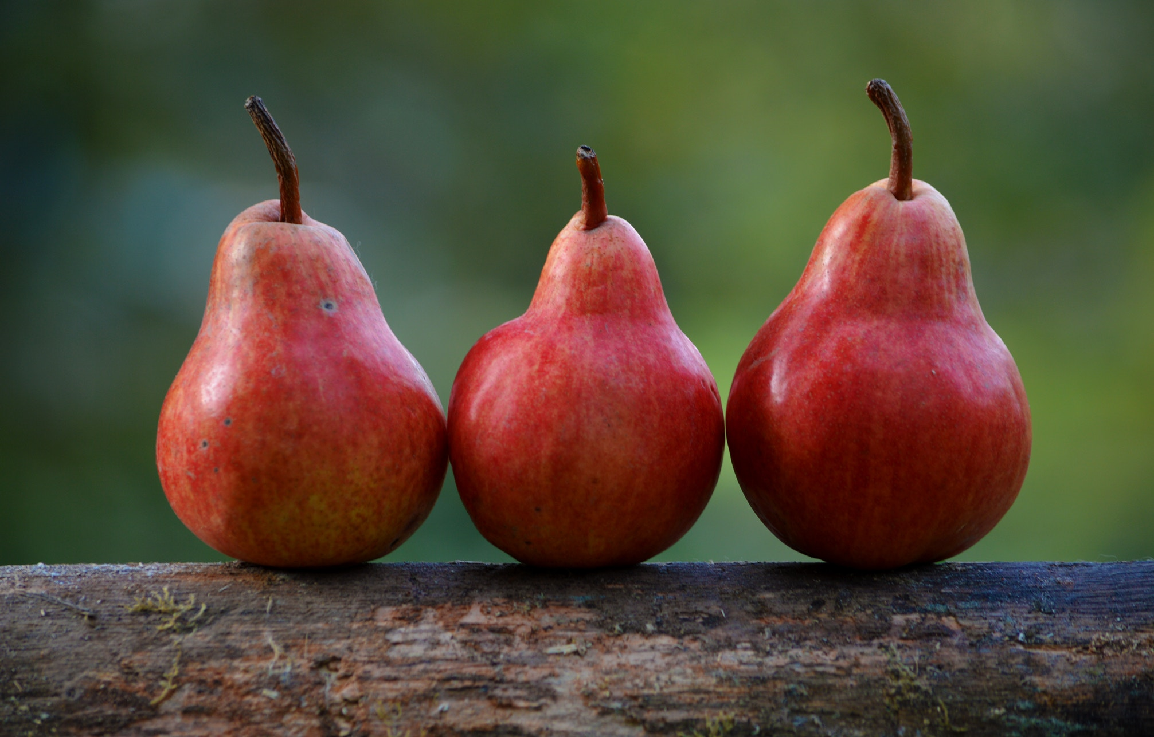
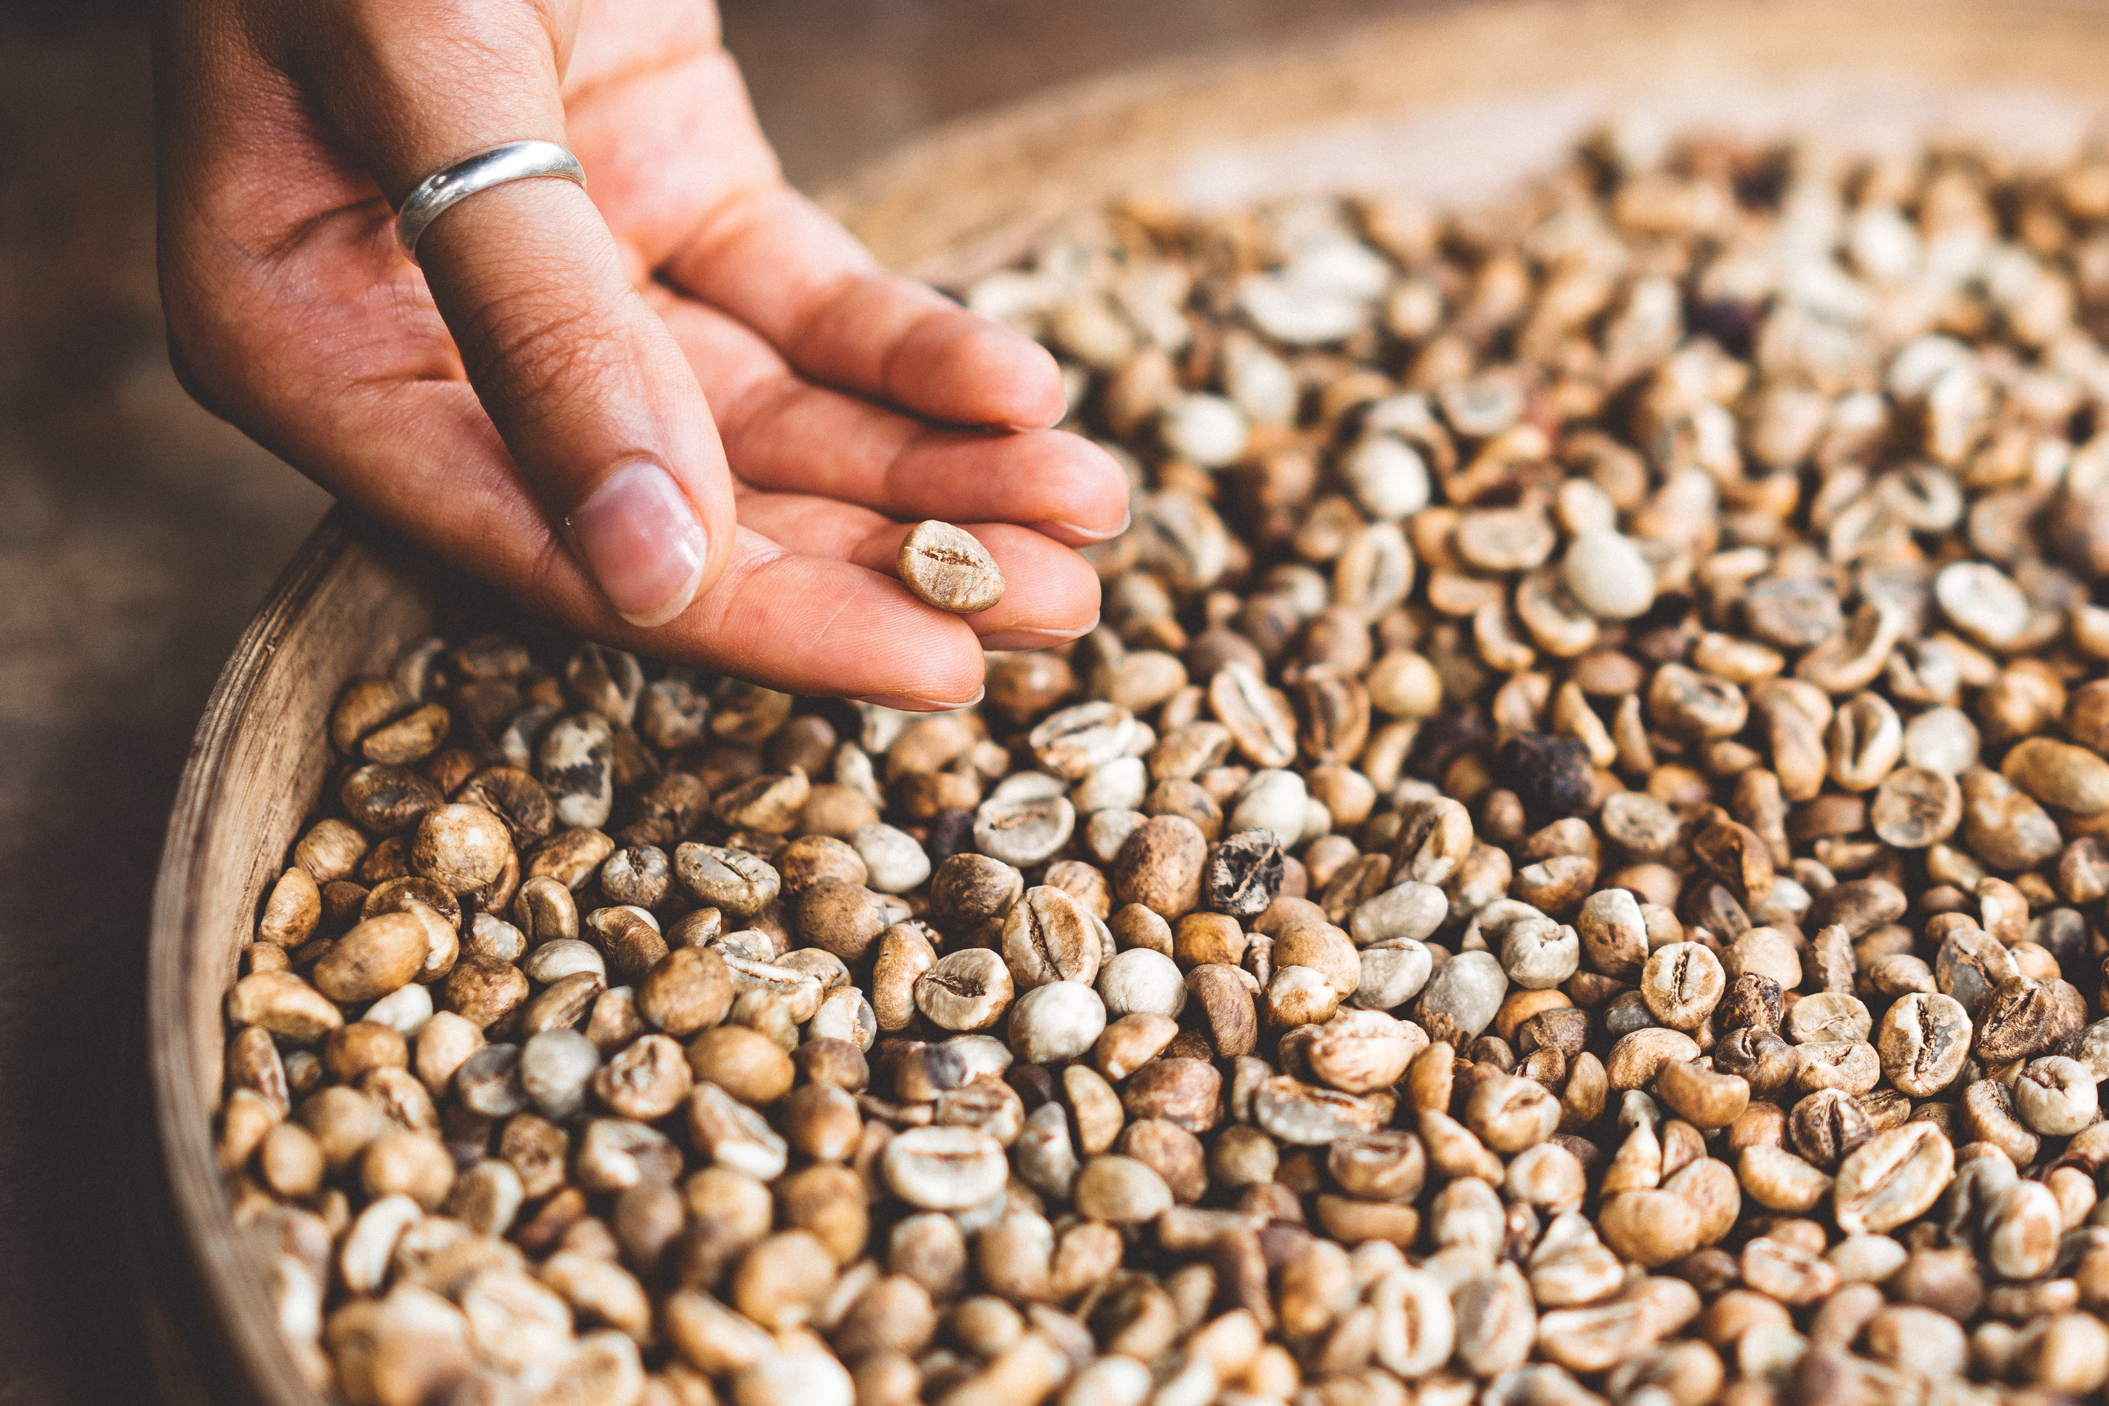
CARBS
Fruit
  Bananas and apples are easy and affordable
  Dried fruit is convenient, but packs a lot of calories and sugar into a small serving
Grains
  Crackers, tortilla chips, cereals, plain popcorn
  Go for 100% whole grain when possible

Slide 4
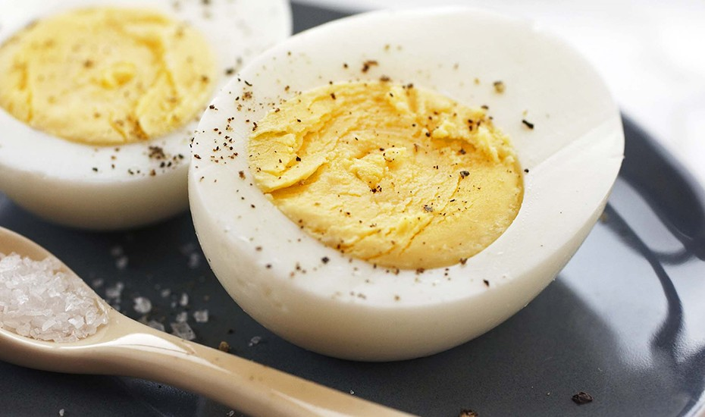
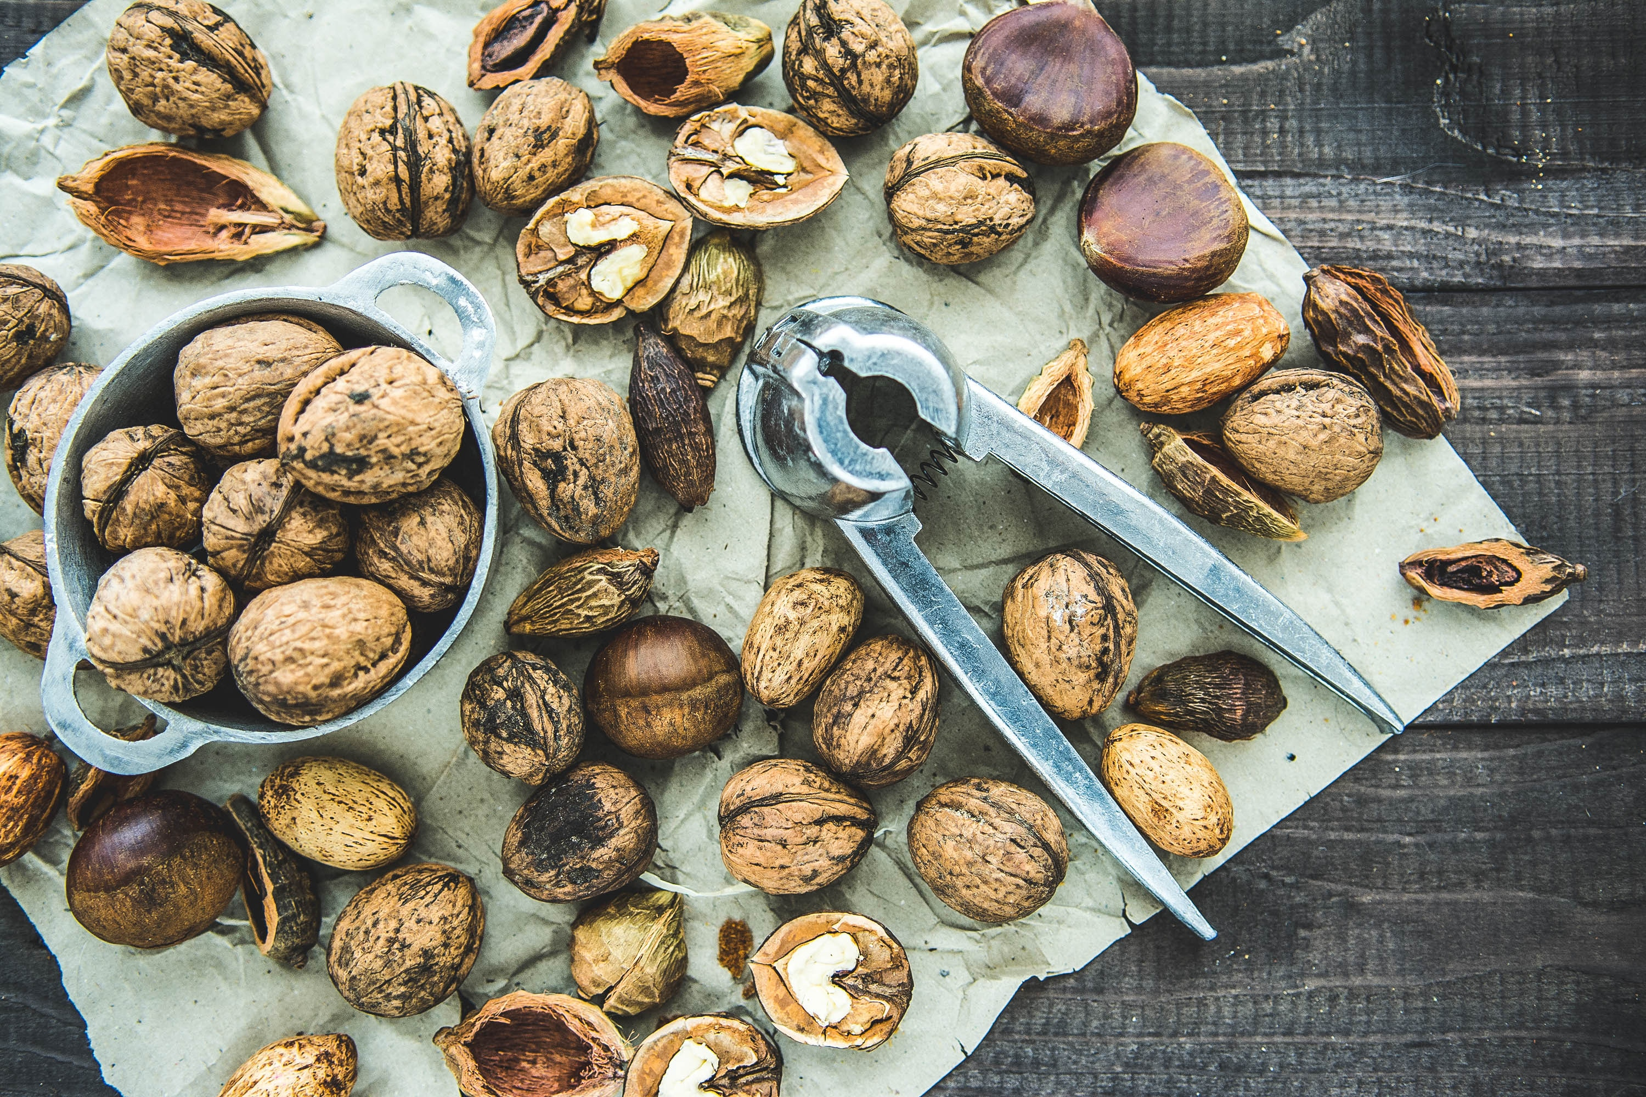
PROTEIN
Animal protein
  “Natural” deli meats
  Hard-boiled eggs
  Canned fish: tuna, salmon, sardines
    Salmon and sardines are also heart-healthy fats
  Cheese
  Yogurt
Plant protein
  Hummus
  Nuts and seeds: almonds, peanut butter, pistachios, etc.
    Also high in fat and calories so pay attention to your portions!

Slide 5
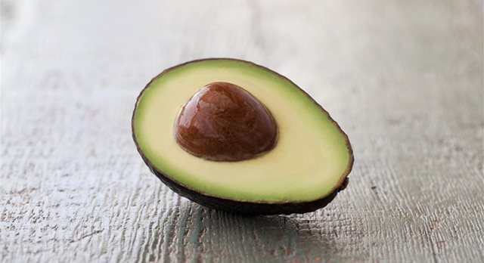
FAT
Nuts and Seeds
  Sunflower seeds, cashews, peanuts, etc.
  Good source of protein and fat
Avocado
Olives
Olive oil and olive oil based mayo
*Remember: fats pack a lot of calories into a small serving, so keep your portions in check
Californiaavocado.com

Slide 6
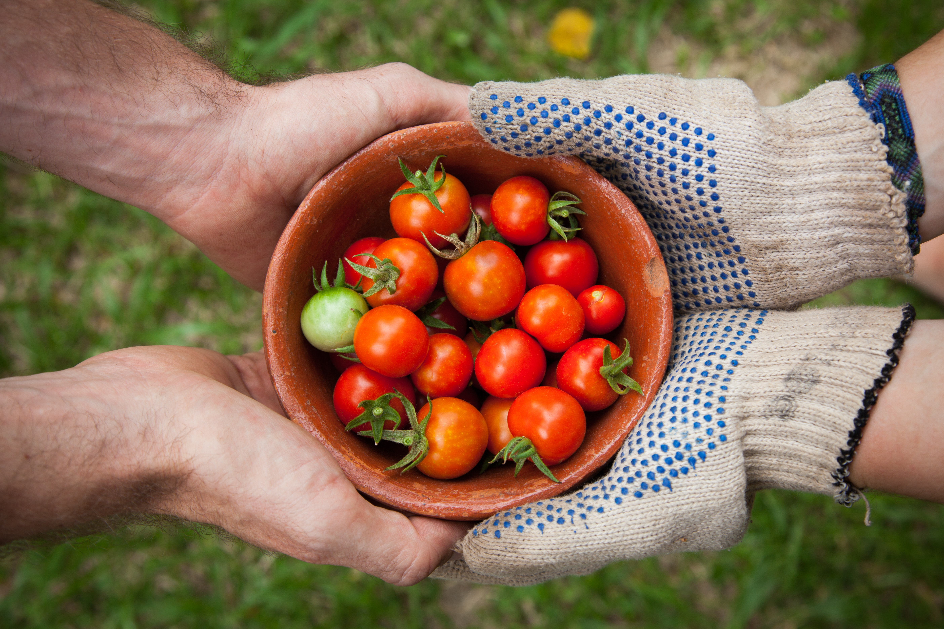
FIBER
Vegetables
  Baby carrots, sliced peppers, cherry tomatoes, celery, etc.
  These are high in vitamins but low in calories
Fruits
  Berries, apples, bananas, etc.
Whole grains
Nuts and seeds: almonds, chia seeds, etc.

Slide 7

Not the best option…
Fat
Carbs (from sugar)
Fiber
Protein

Slide 8
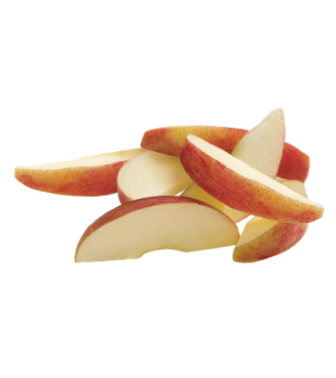
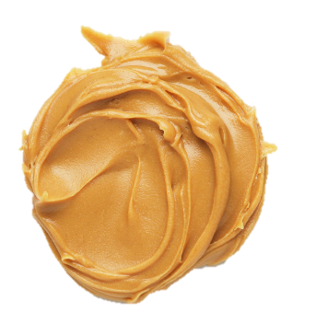
Better option!
APPLE SLICES | + | PEANUT BUTTER
(CARBS + FIBER) |  | (PROTEIN + FAT)

Slide 9
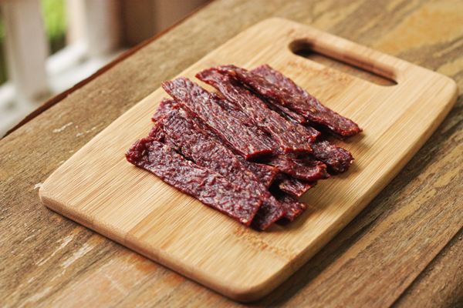
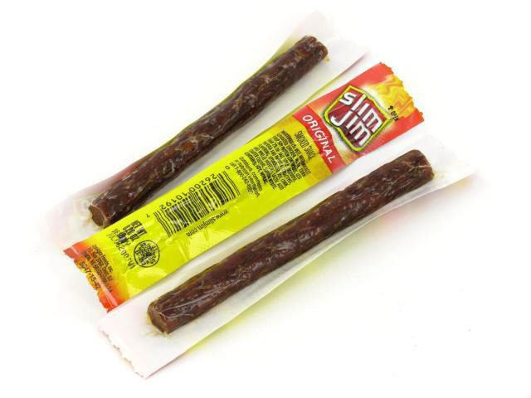
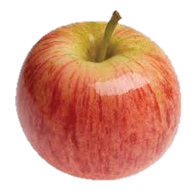
Not the best option… better option!
←Fat
Protein
Fiber
Carbs
Fat→
Protein →
+
Fiber→
Carbs→

Slide 10
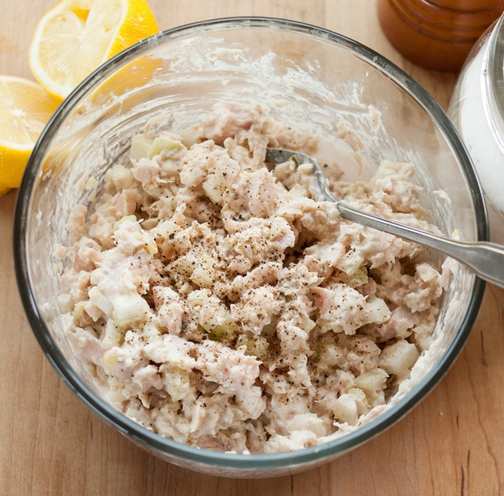
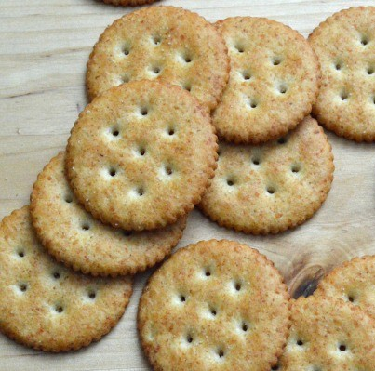
Good option!
1 Can Tuna
2 T mayo
2 T chopped onion
2 T chopped celery
½ T pickle relish
½ T lemon juice
+
TUNA SALAD
(PROTEIN + FAT)
WHOLE GRAIN CRACKERS
(FIBER + CARBS)

Slide 11
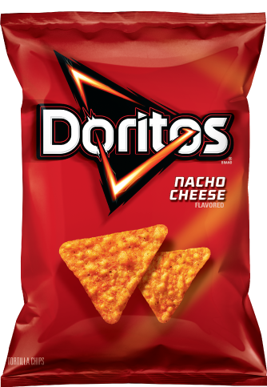
Not the best option…
Fat
Carbs
Fiber
Protein

Slide 12
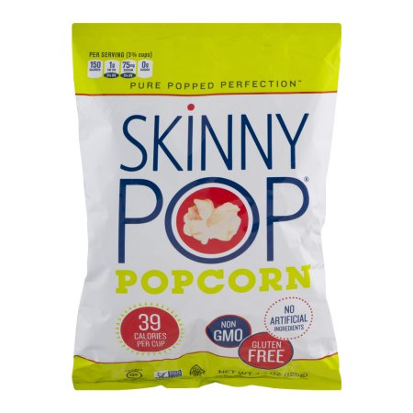
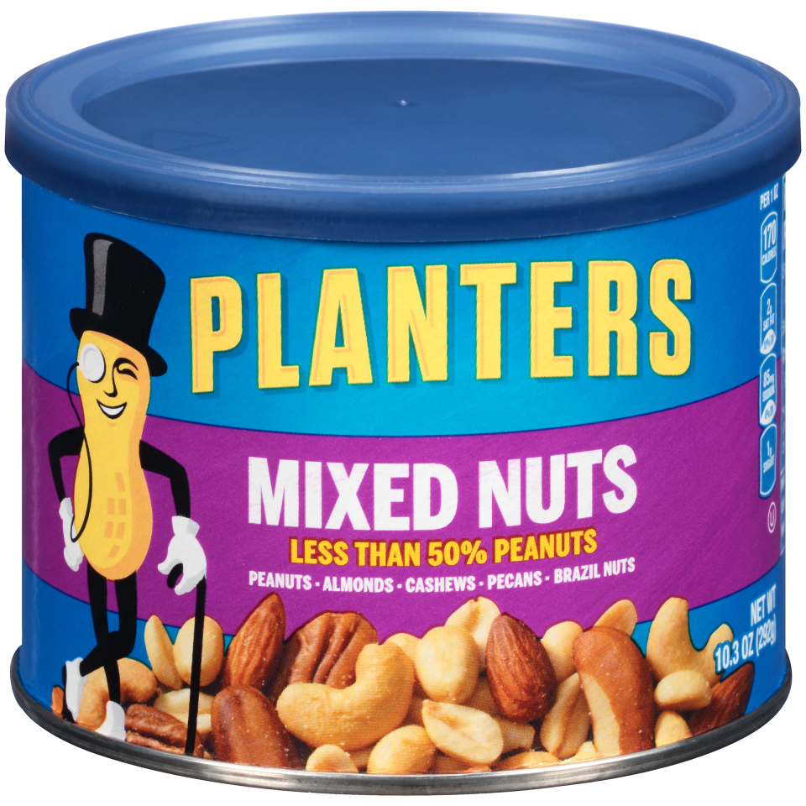
Better option!
←Fiber
← Carbs
Protein →
Fat →

Slide 13
What about beverages?
Proper hydration is important because:
  When we sweat, we lose water
  Fluids carry nutrients to the body’s cells to help it function
      When you are well hydrated, your heart doesn’t have to work as hard!
  Staying hydrated improves physical performance
  Water helps to cushion the body’s joints

Slide 14
What if you don’t drink enough water?
Signs of dehydration
Fatigue
Flushed skin
Light-headedness
Dark-colored urine
Confusion
Headache
  Risk of dehydration, especially in summer months
  Body unable to maintain temperature and may overheat
  Affects mood and brain function

Slide 15
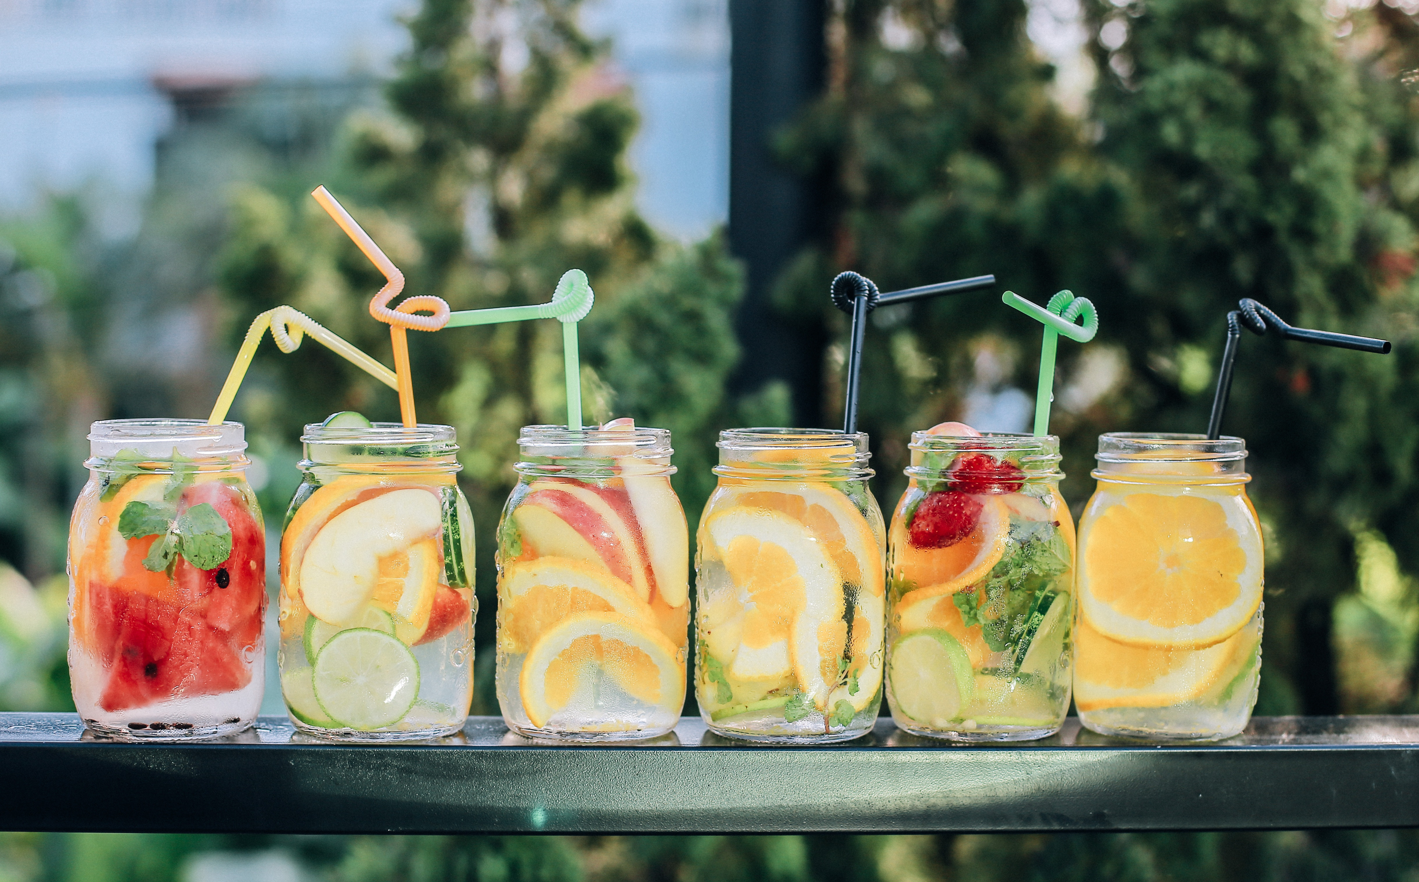
How much fluid do you need?
  Depends on a variety of factors
      Activity level
      Your health
      Environment
      Metabolism
  In general, 6-8 cups of fluid daily
  *(actual fluid needs are very individualized)
  You may need more than this if:
      You are working in hot conditions (even if you are inside!)
      You perspire heavily
      Your urine is a dark yellow or amber color

Slide 16
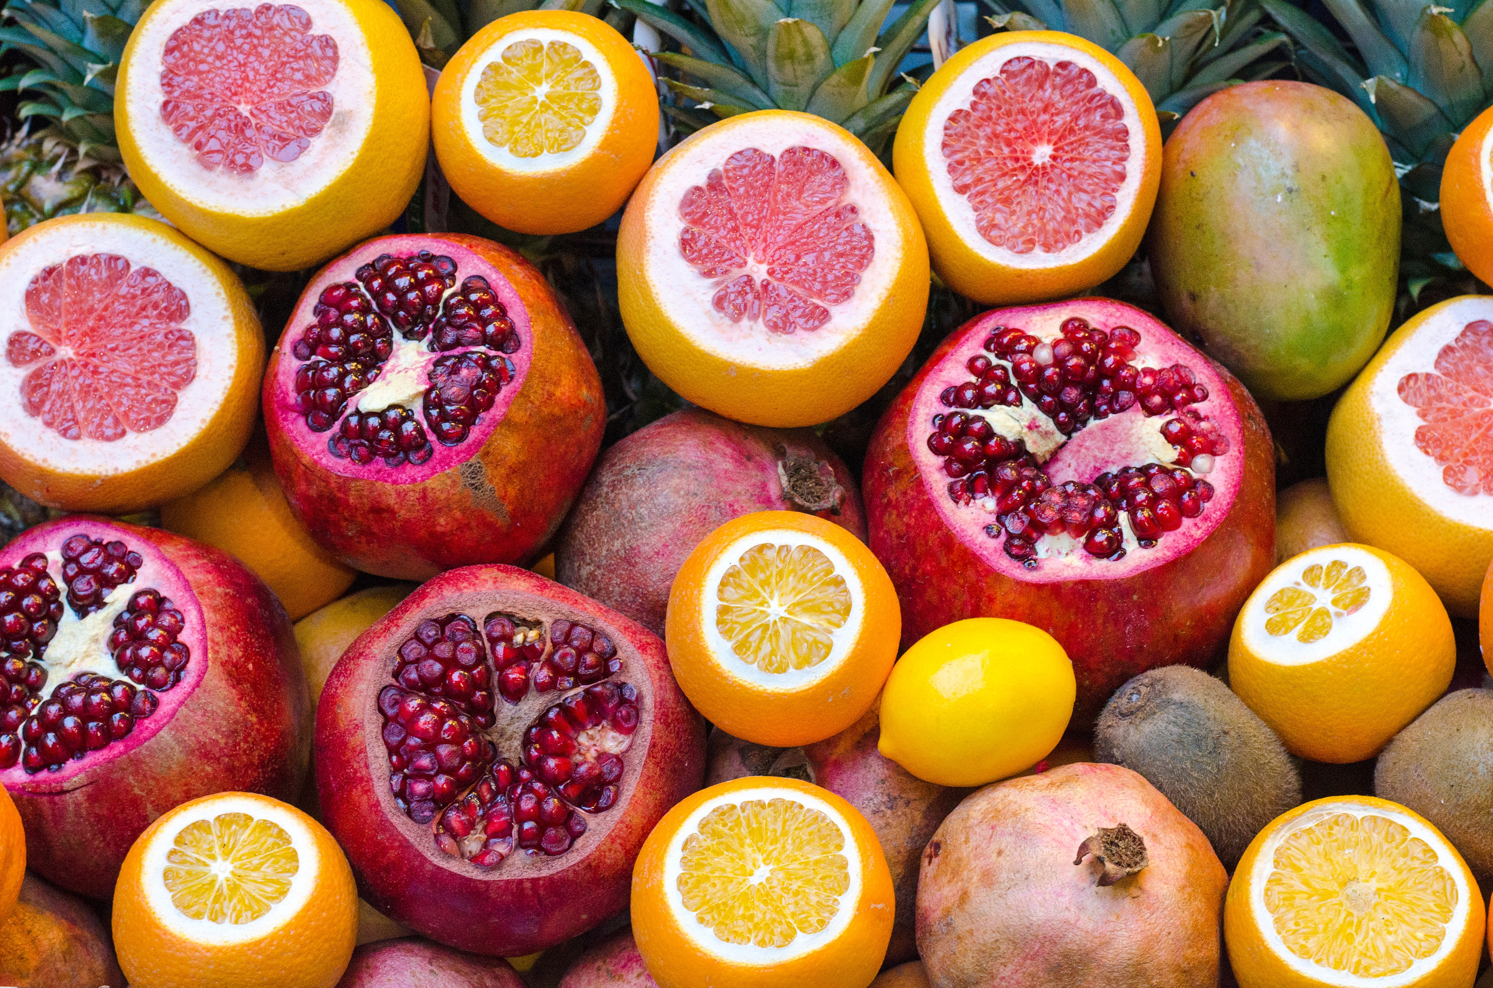
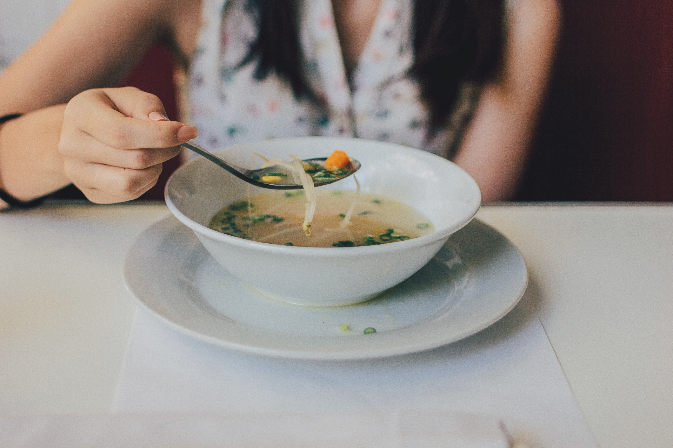
What counts as fluid?
  Water is best!
  Fruits and vegetables with high water content
      Cucumbers, celery, tomatoes, green peppers
      Watermelon, strawberries, cantaloupe, grapefruit
  Soup broths
  Milk
  Smoothies
  Herbal tea

Slide 17
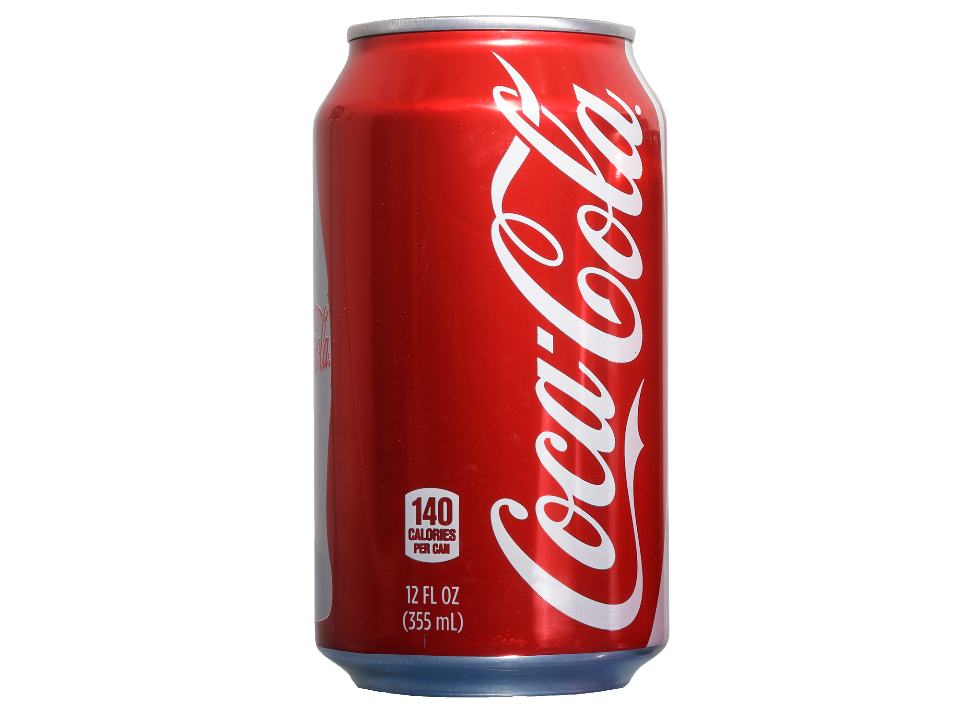
Not the best option…
Fat
Carbs (from sugar)
Fiber
Protein

Slide 18
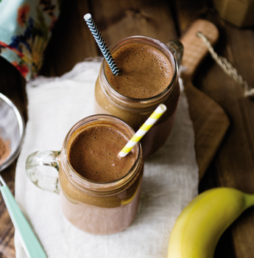
Better option!
SECRETLY HEALTHY MILKSHAKE
2 c. Spinach 2 c. Unsweetened almond milk 3 bananas (try frozen!) 4 Tbsp cacao powder 2 tablespoons almond butter or peanut butter | Fiber Carbs and fiber Fat and protein

